Slide 1
Calvary Preschool
Developmental Milestones

Slide 2
Developmental Milestones
Three-Year Old
Four-Year Old
Five-Year Old

Slide 3
Developmental Milestones
Social-Emotional
Language
Physical-Motor
Creative
Cognitive

Slide 4
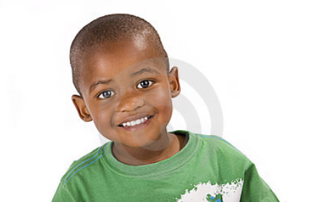
Three-Year Old
Social-Emotional
-Highly imitative of adults*
-Wants to please adults*
-Responds to verbal suggestions
-Easily prompted; Redirected
-Can be bargained with, reasoned with
-Begins to share, take turns, wait
-Exuberant, talkative, humorous
-Has imaginary companions
-Can have nightmares, animal phobias, demonstrates fears
-Plays cooperatively with others*
-Plays spontaneously in groups
-Asserts independence often
-Often stymied, frustrated, jealous
Language
-Talkative with or without a listener
-Begins to listen to learn*
-Likes new words (uses 300-1000 words)
-Increases use of pronouns, prepositions
-Uses “s” “ to indicate plural nouns
-Uses “ed” to indicate past tense
-Uses sentences of 3 or more words
-Says “Is that all right?” a lot
-Puts words into action
-Substitutes letters in speech (i.e. “w” for “r”)
-Intrigued by whispering

Slide 5
Three-Year Old
Physical-Motor
-Loses body fat; Has well-balanced body lines
-Walks erect; nimble on feet
-Gallops in wide, high steps; Balances on 1 foot
-Alternates feet in stair climbing
-Suddenly starts, stops, turns corners rapidly
-Swings arms when walking
-Jumps up and down with ease
-Achieves bladder control; Uses toilet alone
-Washes hands unassisted
-Rides a tricycle
-Unbuttons buttons; Puts on and takes off wraps with help
-Grasps with thumb and index finger
-Has some finger control with small objects
-Pours easily from small pitcher
-Holds a cup in one hand
-Can carry liquids
Creative
-Dramatizes play
-Enjoys slap-stick humor
-Laughs easily
-Experiments with silly language
-May have an imaginary companion
-Acts out versions of own stories
-Enjoys simple poems/rhymes
-Learns color concepts

Slide 6
Three-Year Old
Cognitive
-Alert, excited, curious
-Asks “why” questions constantly
-Matches people according to physical characteristics*
-Enjoys making simple choices
-Has a lively imagination*
-Enjoys guessing games and riddles
-Understands “Let’s pretend . . .”
-Often overgeneralizes*
-Has a short attention span
-Carries out 2 to 4 directions in sequence
-Understands “It’s time to . . .”
-Names and matches simple colors
-Has number concepts of one and two
-Understands size, shape, and comparisons
Cognitive (Continued)
-Often colors pages one color
-Recognizes simple melodies
-Distinguishes between night and day

Slide 7
Four-Year Old
Social-Emotional
-Mood changes rapidly
-Tries out feelings of power; Tests limits
-Dominates; can be bossy, boastful, belligerent
-Assertive; Argumentative
-Shows off; Noisy; Grabs; Insists on own desires
-Easily overstimulated; excitable
-Impatient in large groups
-Cooperates more in smaller groups of 2-3
-Develops special friends, but shifts loyalties often
-“In” group develops; excludes others
-Exaggerates; tells tall tales
-Teases; has a terrific sense of humor
-Tattles frequently
Language
-A great talker; questioner
-Asks many “when?”; “why?”; and “how?” questions
-Likes words, plays with them
-Joins sentences together
-Has a high interest in poetry/rhymes
-LOVES BEING READ TO
-Interested in dramatizing songs and stories
-Uses voice control, pitch, and rhythm
-Enjoys taking turns to sing along
-Beginning to talk to solve conflicts*
-Responds to verbal directions

Slide 8
Four-Year Old
Physical-Motor
-Longer, leaner body build; Active until exhausted
-Hops; Skips; “Works”; Builds
-Hops and stands on one foot
-Jumps and lands upright
-Jumps over objects
-Walks in a straight line
-Alternates feet going down stairs; Races up and down stairs
-Throws a large ball; kicks accurately
-Turns somersaults; Walks backwards
-Draws stick figures
-Holds a paint brush in an adult manner; pencil in a fisted grasp
-Dresses self except back buttons and ties
-Laces shoes
Creative
-Is adventurous; Shows a vivid imagination
-Loves new things
-Finds ways to try to solve problems
-Demonstrates more elaborate dramatic play
-Displays great interest in violence in imaginary play
-Exaggerates and goes to extremes
-Combines words and ideas
-Makes up new words, sounds, and stories
-Enjoys complexity in books and illustrations
-Likes funny poetry/rhymes
-Puts on elaborate plays with puppets or props
-Tells spontaneous stories with artwork

Slide 9
Four-Year Old
Cognitive
-Questions constantly; Interested in how things work
-Has a dynamic intellectual drive*
-Full of ideas; Has imaginary playmates
-Interested in the concepts of life-death
-Begins to generalize; Often faulty assumptions
-Has an extended attention span
-Can do 2 things at once
-Works for a goal*
-Has an accurate sense of time
-Dramatic play is closer to reality
-Identifies which of 2 concepts/objects are larger
-Has a concept of 3; Can name more numbers
Cognitive(Continued)
-Produces representative art and names objects
-Gives art projects personal value
-Likes to use a variety of materials
-Beginning to recognize several printed words
(i.e. their name, mom, dad)

Slide 10
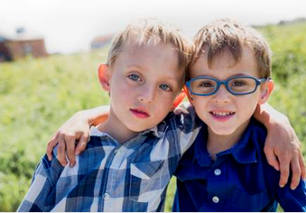
Five-Year Old
Social-Emotional
-Poised; Self-confident
-Has a sense of self-identity
-Needs to be right; Persistent
-Sensitive to ridicule*
-May get silly or wild
-Likes pointless riddles and jokes
-Enjoys group play and competitive games*
-Aware of rules and defines them for others
-Insists on fair play
-Sociable; Chooses own friends
-Likes adult companionship
-Accepts, respects authority
-Asks permission; Remains relatively calm in emergencies
Language
-Uses bigger words and talks in complete sentences
-Defines and spells some simple words
-Has clear ideas and articulates them*
-Thinks out loud*
-Takes turns in conversations
-Uses words to give and receive information
-Asks questions to learn answers*
-Insists “I already know that”
-Makes up songs
-Enjoys dictating stories
-Retells familiar stories

Slide 11
Five-Year Old
Physical-Motor
-Adult like posture
-Coordinated
-Handedness is evident
-Likes to use fine-motor skills
-Learning how to tie a bow knot
-Draws a recognizable person*
-Cuts on a line with scissors
-Begins to color within the lines
-Catches a ball from 3 feet away
-Skips using alternate feet
-Enjoys jumping, running, doing stunts
-Balances on a balance beam
-Likes to dance; is graceful; rhythmic
-Sometimes roughhouses and fights
Creative
-Fantasy play is more active, less verbal
-Thinks out loud
-Has creative ideas; Loves to talk about them
-Explores a variety of art processes
-Has ideas of what to draw; Strives to make something recognizable
-Likes to copy
-Enjoys making patterns, designs
-Becomes engrossed in details of painting, blocks, and creative play
-Learns simple dance routines
-Puts on simple plays

Slide 12
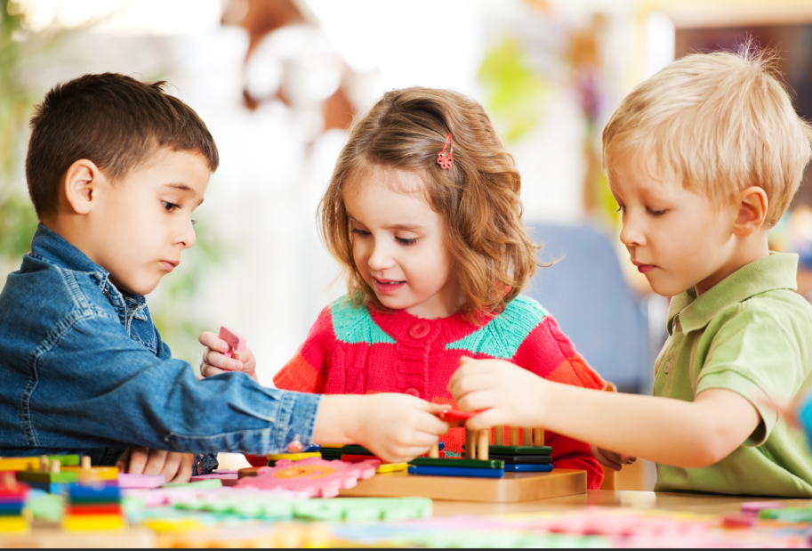
Five-Year Old
Cognitive
-Curious about everything
-Wants to know “why?” and “how?”
-Likes to display new knowledge and skills
-Somewhat conscious of ignorance* (things they don’t know)
-Attention span increases noticeably
-Decides on a plan, follows it, centers on task
-Understands the concepts of tomorrow and yesterday
-Can count 10 objects, Rote counts to 20 or beyond
-Sorts objects by single characteristics* (i.e. color, shape)
-Understands the concepts of smallest, less than, one-half
Cognitive (Continued)
-May tell time accurately to the hour
-Knows the purpose of a calendar
-Knows their name, address, and town they live in
-Seldom sees things from another person’s point of view

